Slide 1

Reducing Audio Bandwidth with an FFT-based Low-Pass Filter
Andy Henshaw, Trent Geisler, Lauren Staples
MATH 7900 Final Project

Slide 2
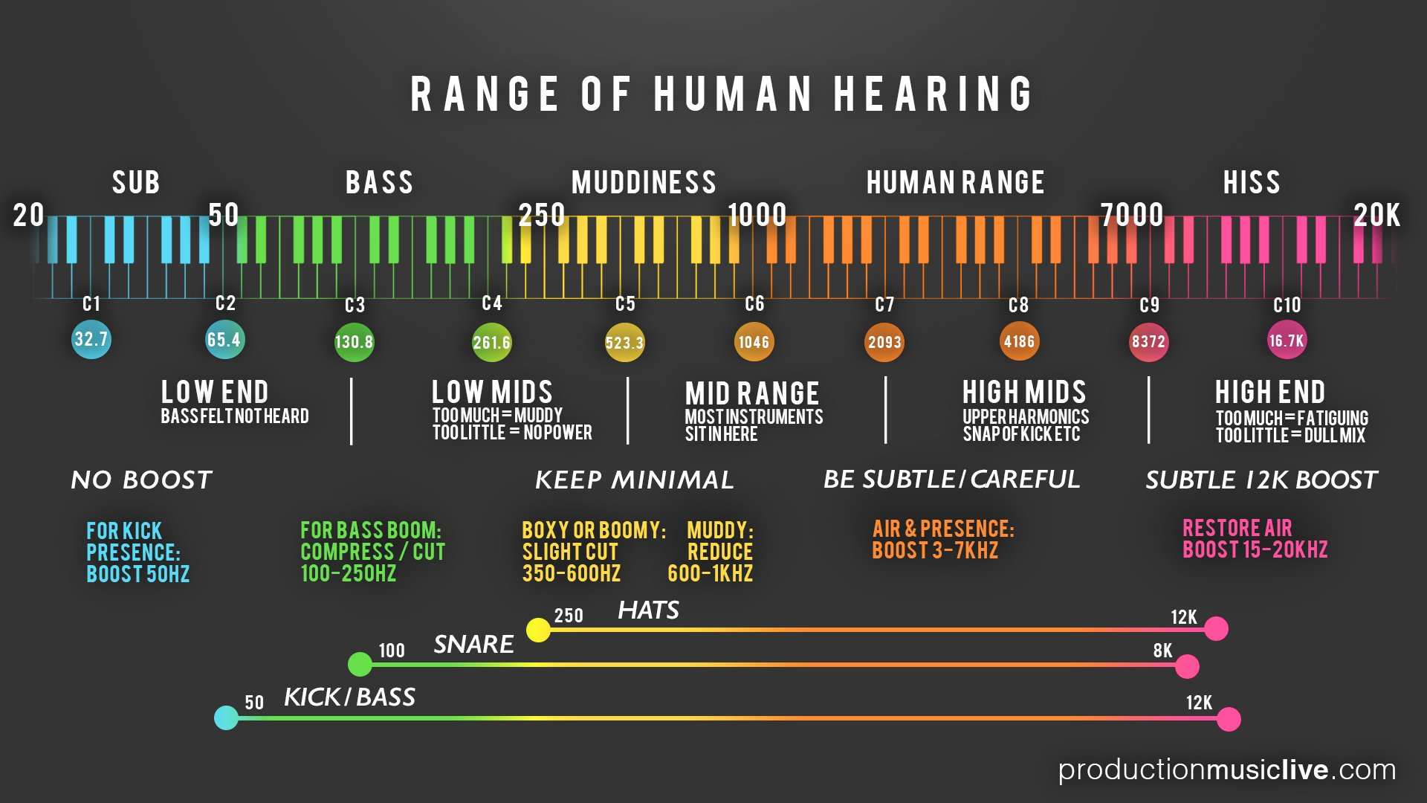
http://onlinetonegenerator.com/hearingtest.html
Notes:
Graphic found at: https://cdn.shopify.com/s/files/1/0993/3800/files/PML_Infographic_-_Audio_Spectrum_2_www.productionmusiclive.com.jpg?_ga=2.91947928.326704852.1575220839-1784720854.1575220839
< C8 is piano. 1st note is 27.5 on the piano. Lowest note is the

Slide 3
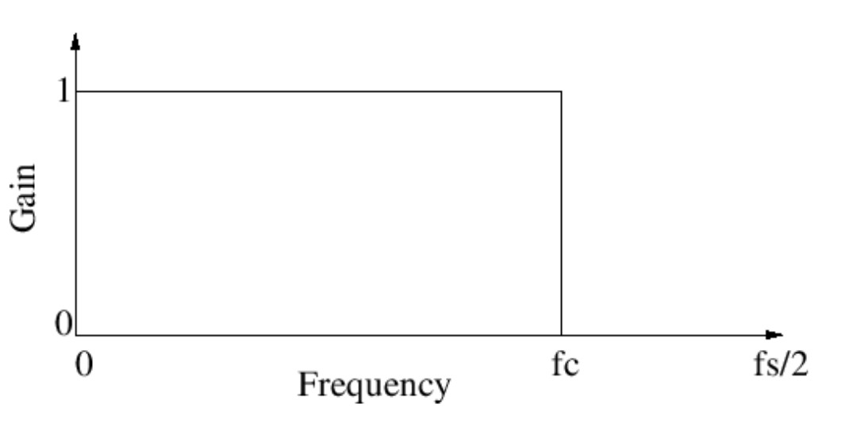
Ideal Low-Pass Filter Design
Notes:
A reduction in bandwidth – when transmitting a shorter “range” bandwidth there are power savings in the transmission. Important because its expensive to transmit long distances and requires a great deal of power.
Gain is a way to amplify something.

Slide 4
Typical Low-Pass Filter Design
Notes:
A sharper transition band -> becomes more computationally expensive (more complex filter in the time domain).
Until recently, it wasn’t practical to use FFT to implement a real-time filter

Slide 5
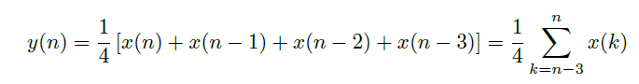
Filter Example: 4-Tap Average
Impulse Response and Filter Coefficients are the same thing!
Notes:
Talk through the diagram…how information flows into the block diagram
- In the time domain, the filter shown in (a) is really a convolution. The other way to do the filter, you can transform into the frequency domain

Slide 6
Output Spectrum: Multiply in Frequency Domain

Slide 7
Filter Design Tool – Frequency Response
Notes:
What the filter design tool will do for us is to give us the Frequency Response of the filter based off of a few desired characteristics.
It’s called ripple (in stopband) and it’s a consequence of the algorithm used to create the filter. There are many different algorithms to do this.

Slide 8
Filter Design Tool – Filter Coefficients
Notes:
Finally, we can easily obtain the filter coefficients from the Frequency Response by taking the Inverse FFT of the Frequency Response information. The FIR filter coefficients are what is used in other tools to implement the filter design.
Put SINC function on side of this.

Slide 9
Magic?
Source: https://imgur.com/gallery/LLUgVSz
Notes:
……….or does the camera speed match the speed of the helicopter? Should we increase or decrease the camera shutter speed to capture the true signal? The helicopter blades are periodic, similar to audio signals.

Slide 10
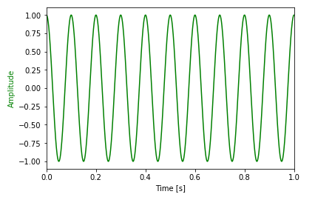
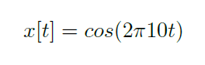
Example Audio Signal

Slide 11
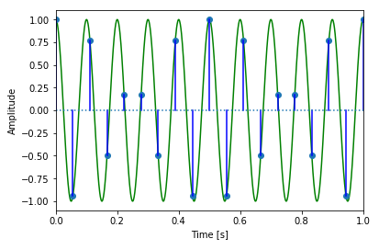
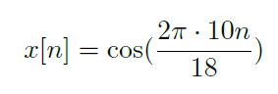
Under-sampled at 18 Hz:
Notes:
N being an index of samples, starting at 0. We arrive here by plugging in n/18 for t.

Slide 12
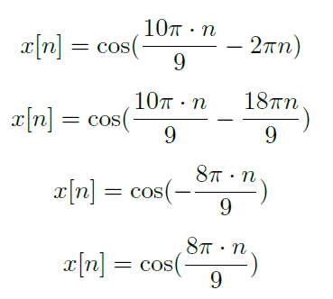
Under-sampled at 18 Hz, continued:
Notes:
Because the cosine function is periodic, adding or subtracting a full period of 2pi inside the function does not change the function. The alias is caused by whatever is leftover after subtracting a full period. Cosine functions are also even functions, so negative terms become even. 8pi*n/9 is the alias created by our undersampling.

Slide 13
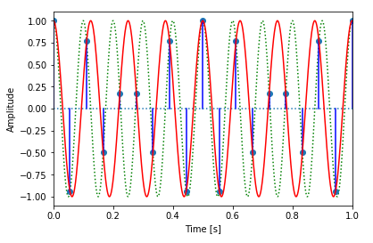
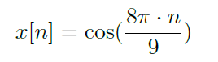
Under-sampled at 18 Hz:
Notes:
There are multiple curves that intersect with our sampling points. The red curve is the curve reconstructed from the alias term caused by our under-sampling.

Slide 14
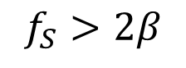
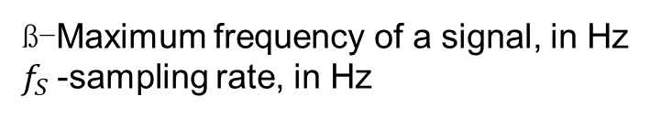
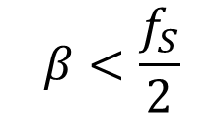
The Nyquist-Shannon Theorem
$$β<\frac{f_{S}}{2}$$
ß-Maximum frequency of a signal, in Hz
$f_{S}$-sampling rate, in Hz
$$f_{S}>2β$$
Notes:
“if a function x( t ) contains no frequencies higher than B hertz, then it is completely determined by giving its ordinates at a series of points spaced 1 / ( 2 B )
seconds apart. It then follows that a sufficient sampling rate (nyquist rate) is therefore twice the maximum frequency $B$ hertz, $2B$ \cite{shannon:wiki}.

Slide 15
How the Standard CD frequency arrive at 44.1 kHz?
Humans hear from 20-20,000 Hz.
From this, we know that the sampling rate should at least be 40 kHz.
Audio signals still have to be passed through an anti-aliasing filter, or low-pass filter.
Even though humans cannot hear beyond 20 kHz, these frequencies can still cause aliasing.
The remaining 4,100 Hz?
A transition band allows greater ease of anti-aliasing filtering.
Notes:
The transition band is the area between the passband and the stopband.
So, if we want a filter to pass 0-20Khz without attenuation (reduction), that’s the passband. Typically, we want to reduce signals outside of the passband by 40 dB or more. That’s the stopband. However, if our passband ends at 20 KHz and our stopband starts at 20 KHz, then the transition area is 0. So, our filter needs to be perfectly “sharp”. If our stopband started at 22.05 KHz, then our transition is 2.05 Khz, which is much less sharp.
The complexity of a filter is mainly due to how sharp it is. On the analog side, a sharper filter has more complex hardware and will cost more. On the digital side, a sharper filter means more calculations. Either way, it is of benefit to have a softer filter (less sharp), which means a bigger transition band. A transition band that is about 10% of the passband is common.

